Slide 1
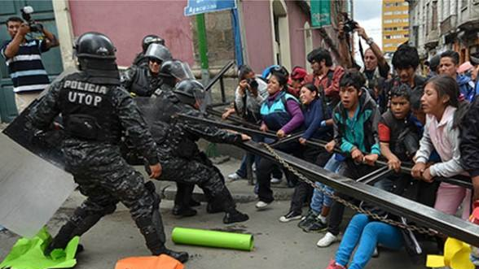
Child Labour: Joining the dots of inequality and power
Dr Chris O’Connell

Slide 2
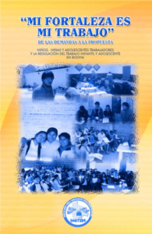
Bolivia, 2013-14
850,000 children economically active (UNICEF)
Almost half under 14 years of age (ILO minimum age)
Successive (>6) years of mobilisation by NATS (Child and Adolescent Worker Societies) around new Constitution and beyond
New Child and Adolescent Code (2014) promised a new approach to child labour
Human Rights Frame:
“Working children and adolescents are primarily human rights subjects (...) the State is obliged to protect those rights, including the right to work and to participate in public life with their own opinion and participation; in short, addressing the regulation of child labour within a framework of human rights protection could imply a much more comprehensive framework of obligations’ compliance and exercise of rights.”
UNATSBO, 2010
Notes:
The 2014 Code expressly forbids “every form of violence against children, in the family or in society”, but does not issue a blanket ban on child labour. “Forced labour and exploitation of children” are not permitted. How­ever, the document states that “the activities that children perform in their families and social environments promote their development as citizens; they have an educational function”.

Slide 3
Bolivia, 2013-14
“Child labor shouldn’t be eradicated; yet children should not be exploited or forced to work. Some work out of necessity. To eliminate children and adolescents’ work is to eliminate their social conscience”.
President Evo Morales, December 2013
Result: ‘Controversial’ Child and Adolescent Code 2014
Very different approach
Polarised responses
“Children should not be at work or employment below the minimum age, which should be the age where you end compulsory schooling. Bolivia is the only country in the world that goes this way.”
Jose Ramirez, International Labor Organization (ILO)
“The law does not exist to create more children workers, it exists to protect the rights of the children who already work.”
Lizeth Castro, UNATSBO
“If you criminalize children, God knows what happens to them.”
Viviana Farfán, Save the Children Bolivia

Slide 4
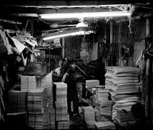
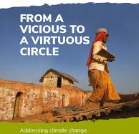
Biographical Profile
PhD from in Politics from School of Law & Government, DCU
IRC/European Commission CAROLINE Research Fellow, 2018-22
Seconded to Anti-Slavery International 2018-2020
Focus on climate change and modern slavery
Field research in Andean Region of South America
Author of ‘From a Vicious to a Virtuous Circle’ report, 2021 and ‘The Modern Slavery Series’, 2022

Slide 5
Some broad lessons
Abolition alone is not effective
Estimates about the prevalence of modern slavery are, at the very least, questionable
Tendency to sensationalise these issues by multilateral institutions, national governments and the media
Listening to the voices of survivors and those with lived experience is crucial

Slide 6
Abolition alone is not effective
Three P’s … or only one?
Criminal justice approach proven as too blunt
Linked to ‘collateral damage’ and unintended consequences
Targeting of unwanted groups
The ‘Two P’s’: Politics and participation
Human Rights approaches:
Tendency to focus on ‘negative’ rights – leads to CJA
Importance of ‘Second-generation/positive rights’
Right to Education
Right to Healthcare
Universal social protections

Slide 7
2. Estimates about the prevalence of modern slavery are, at the very least, questionable
Serious issues with the methodologies used by the high-profile Global Slavery Index and ILO Global Estimates of Modern Slavery
Comparing apples and oranges?
Lack of transparency about methods for data collection
Extrapolation based on subset
Reliability and accuracy of data questioned
Similarities with the ILO Global Estimates on Child Labour
Survey data: Who, how and when we ask
Broad definitions designed to ‘capture’ high numbers … 160 million
Notes:
Children are considered to be in child labour when:
They are aged 5-11 years and have worked for one hour or more in any form of work except for unpaid household activities.
They are aged 12-14 years and have worked for 14 hours or more, including after school or during holidays.
They are aged 12-17 years and have worked for one hour or more in predefined hazardous industries or hazardous occupations (e.g., mining, quarrying, construction).
They are 15-17 years and have worked 43 hours or more per week.

Slide 8
3. Tendency to sensationalise these issues by multilateral institutions, national governments and the media
Big, spectacular goals or pledges (“We will end ISSUE by DATE”)
WHAT exactly is being tackled/eliminated?
HOW will it be done?
Treating ‘worst cases’ as representative
Child Work: 218 million
Child Labour: 160 million
Children in Hazardous Work: 79 million
Child Slavery: 12.3 million
Child Forced Labour: 3.3 million
Notes:
Children are considered to be in child labour when:
They are aged 5-11 years and have worked for one hour or more in any form of work except for unpaid household activities.
They are aged 12-14 years and have worked for 14 hours or more, including after school or during holidays.
They are aged 12-17 years and have worked for one hour or more in predefined hazardous industries or hazardous occupations (e.g., mining, quarrying, construction).
They are 15-17 years and have worked 43 hours or more per week.

Slide 9
4. Listening to the voices of survivors and those with lived experience is crucial
Late but welcome realization of importance of survivor voices in shaping responses – see Durban Call to Action
Point to hybrid approach: not human rights or livelihoods, but BOTH
Also point to the need to analyse power relations across different fields – who is listened to and why/how?
Economic
Social
Politico-legal
Environmental

Slide 10
4. Listening to the voices of survivors and those with lived experience is crucial
Evidence from from 29 Children’s Advisory Committees (CACs) who organised their own research and advocacy initiatives in 2018 and 2019 across 18 countries in Africa, Asia, Latin America, Europe and the Middle East revealed the following key messages that could be useful:
Protect us from labour exploitation, harsh conditions and risks, and allow children to do suitable dignified work
Prevent and protect working children from violence and discrimination
Address poverty; provide decent jobs for our parents; and ensure that our basic needs are met
Take our education seriously and provide quality education and skill training
Listen to us, understand us, and implement laws that respect our rights

Slide 11
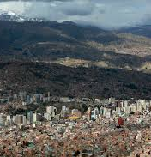
Back to Bolivia
International campaign against Bolivia led by ILO, US
‘I even saw a cover in a European magazine, I think it was English, that said, “Bolivia legalises child work” and it showed the photo of a child miner. A child working in a mine is not a child working, it’s a child being exploited as well. So that image was false, it gave a false image of Bolivia that we are turning a blind eye on children working in the mines or in construction, on this work, that are really detrimental to a person’s development.’
Jaime Villalobos, Save the Children Bolivia
State failure to adequately resource protections, bureaucratic obstacles
But still preferred by NATS
Code struck down in 2019
Covid-19 impacts on education, poverty
“Now, the priority is having something to eat. So education ends up on the back burner.”
Who is listening and why/how?

